Slide 1

The Machine Learning Process
Python 101 – Generators
Sathish Ravichandran

Slide 2

Generators
Generators allow us to generate as we go along, instead of holding everything in memory.
Generator functions allow us to write a function that can send back a value and then later resume to pick up where it left off. This type of function is a generator in Python, allowing us to generate a sequence of values over time. The main difference in syntax will be the use of a yield statement.
Notes:
# Generator function for the cube of numbers (power of 3)
def gencubes(n):
for num in range(n):
yield num**3

Slide 3
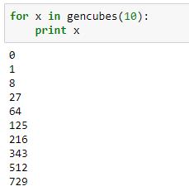
Generators
Notes:
# Generator function for the cube of numbers (power of 3)
def gencubes(n):
for num in range(n):
yield num**3
for x in gencubes(10):
print x

Slide 4
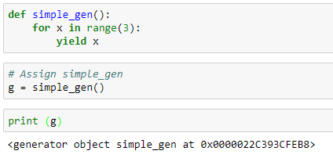

Simple example
So, how do you access value from g
Notes:
def simple_gen():
for x in range(3):
yield x
g = simple_gen()
print (g)

Slide 5
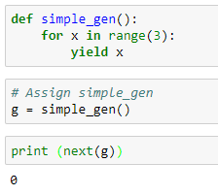
Simple example
It remembers what the previous one was and returns the next value
Generator is not holding everything in memory
Notes:
def simple_gen():
for x in range(3):
yield x
g = simple_gen()
print (next(g))

Slide 6
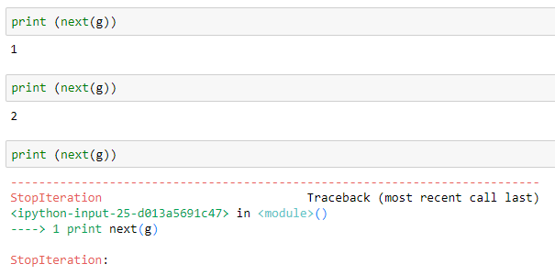
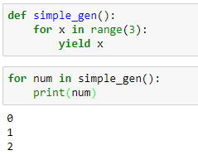
Simple example
After yielding all the values next() calls stop iteration error
For loop automatically catches the error and stops calling next()
Notes:
def simple_gen():
for x in range(3):
yield x
for num in simple_gen():
print(num)

Slide 7
Simple example
After yielding all the values next() calls stop iteration error
For loop automatically catches the error and stops calling next()
Notes:
def simple_gen():
for x in range(3):
yield x
for num in simple_gen():
print(num)

Slide 8
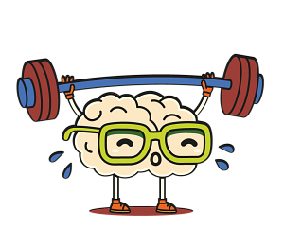















Learning Exercise 01
Create a generator that yields "n" random numbers between a low and high number (that are inputs). Note: Use the random library.
def rand_num(low,high,n):
#your code here
for num in rand_num(1,10,2):
print num
4
7
*not really, we just need two random number

Slide 9

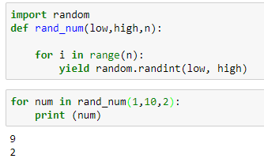
Solution
Notes:
import random
def rand_num(low,high,n):
for i in range(n):
yield random.randint(low, high)
for num in rand_num(1,10,2):
print (num)

Slide 10
Thank you
The Capacity to learn is a gift;
The ability to learn is a skill;
The willingness to learn is a choice.
-Brian Herbert

